Slide 1
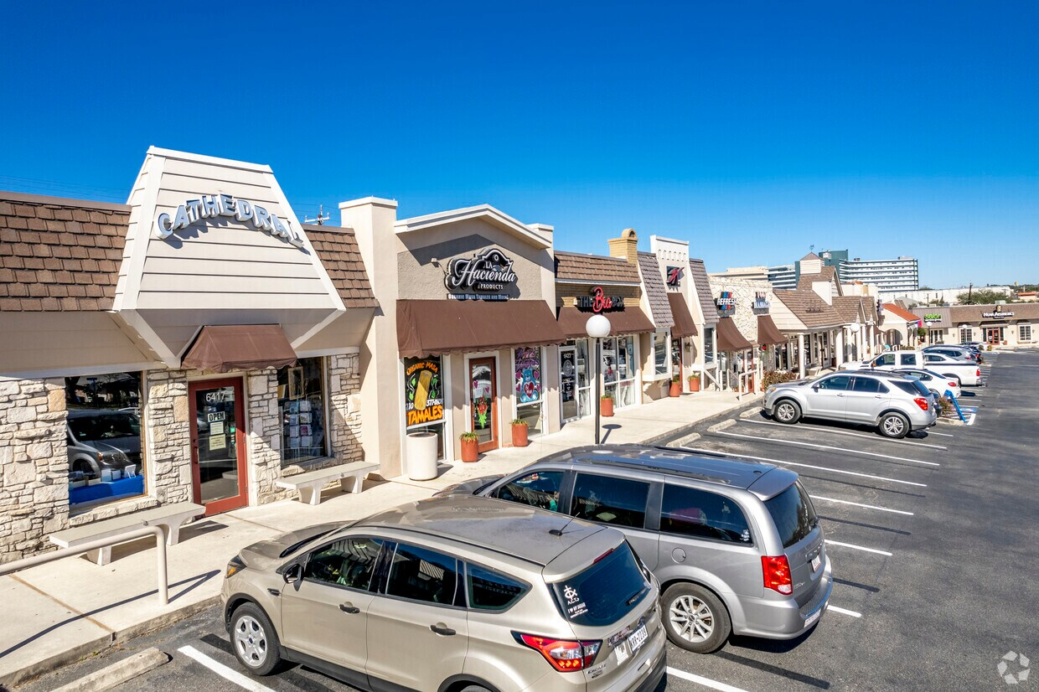
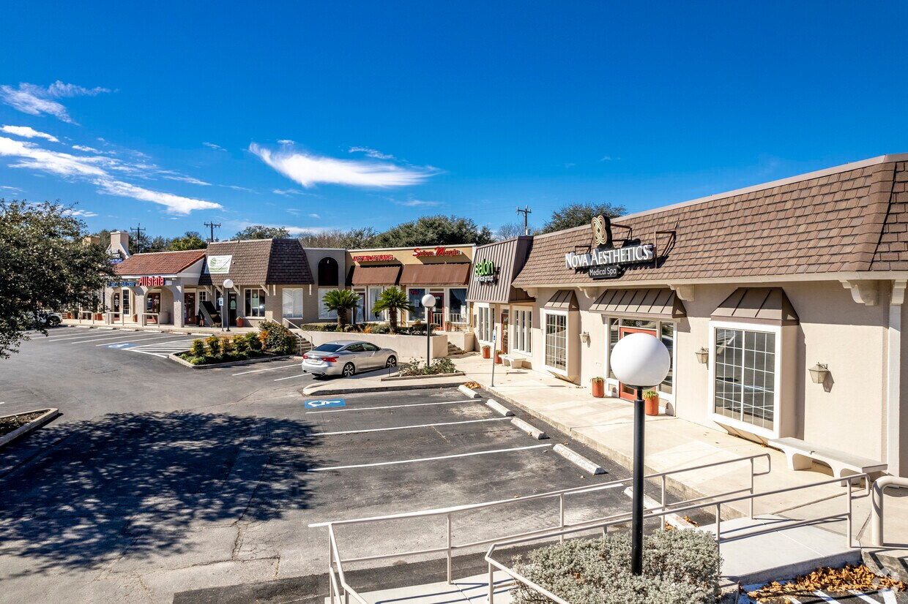
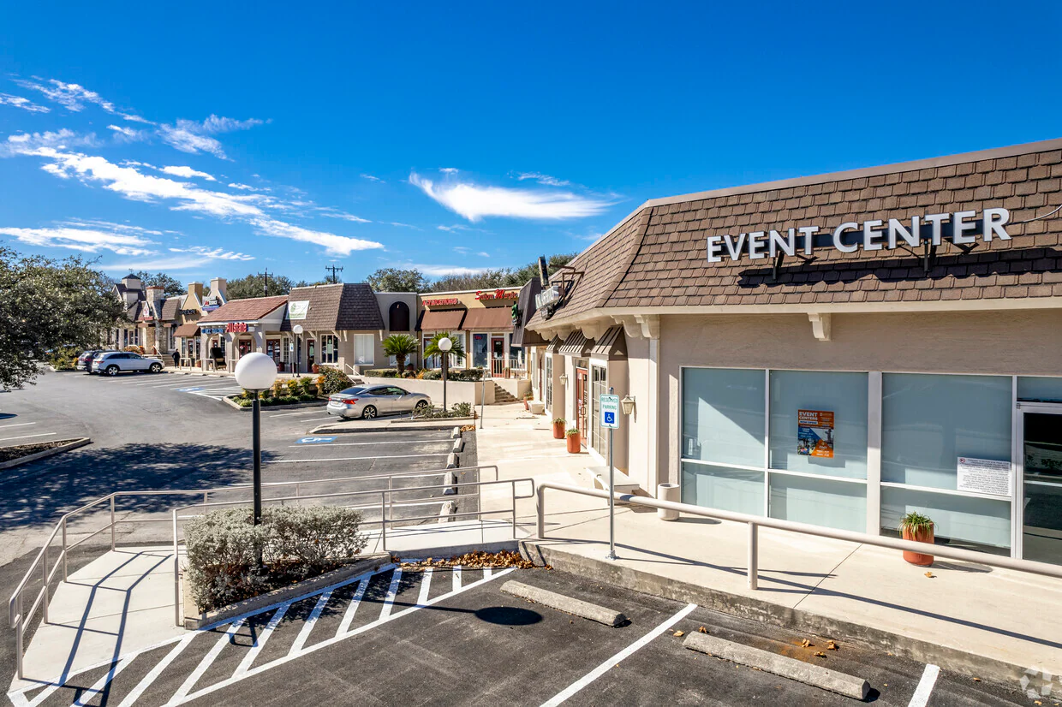
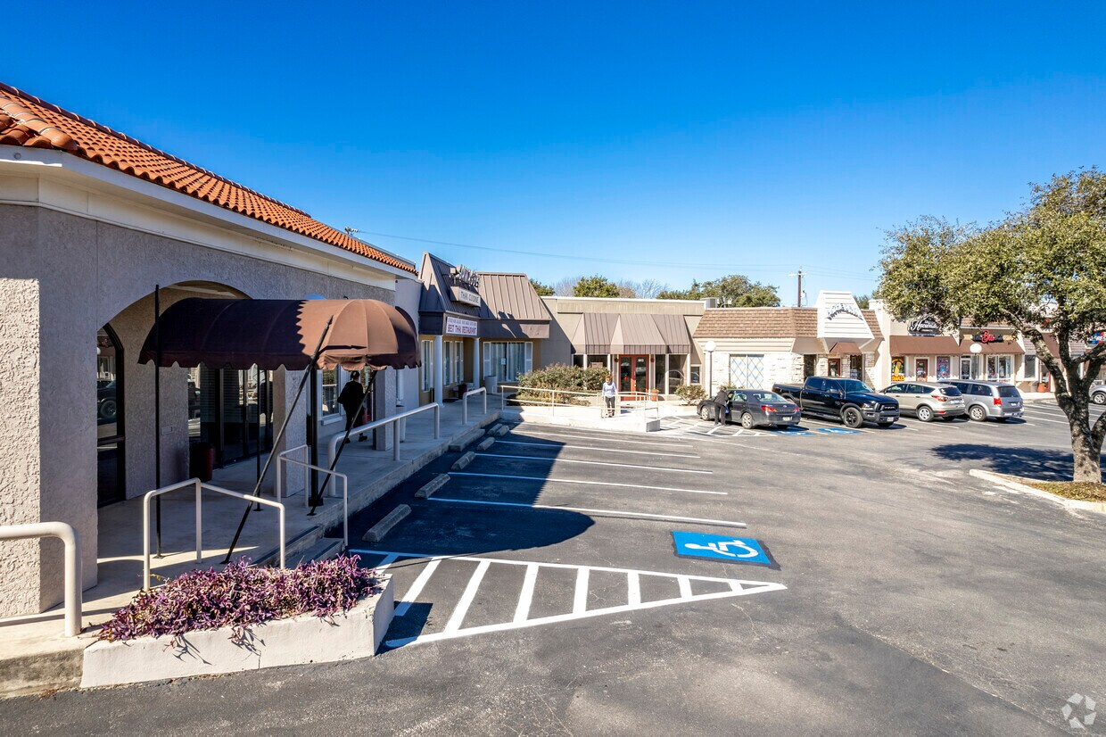
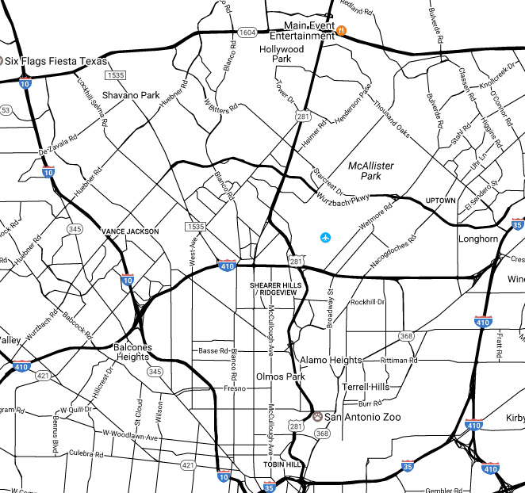
Joe M. Kboudi
REAL ESTATE, INC.
▪ LEASING
▪ MANAGEMENT
▪ INVESTMENTS
Castle Creek Village Shopping Center
6401–6487 Blanco Road ▪ San Antonio ▪ TX ▪ 78216
Property Highlights:
• Established neighborhood shopping center in the Heart of North Central San Antonio strategically located on Blanco Road just south of Loop 410
• Excellent visibility and convenient ingress and egress from Blanco Road with multiple entries
• Over 27,800 vehicles per day per TXDOT
• Strong Demographics (435k population and $91k average household income within 5-mile radius)
• Storefront and monument signage opportunities
• Minutes from Park North Shopping Center, North Star Mall and San Antonio International Airport
• Surrounded by established and densely populated neighborhoods including Castle Hills & Shearer Hills
• Available: 1,470 SF
• Rate: $18.00 PSF + NNN (est. $6.95)
For More Information Contact:
Joe M. Kboudi, Omri Russo
Joe M. Kboudi Real Estate, Inc.
7300 Blanco Road, Suite 706 San Antonio, Texas 78216
TEL: (210) 344-1002
FAX: (210) 342-3405
www.kboudi.com jmkboudi@aol.com
omri@kboudi.com
This information has been secured from sources deemed to be reliable, but we made no representation on warranties expressed or implied, as to the accuracy of the information. References to square footage or age are approximate. Buyer must verify the information and bears all risk of any inaccuracies.

Slide 2


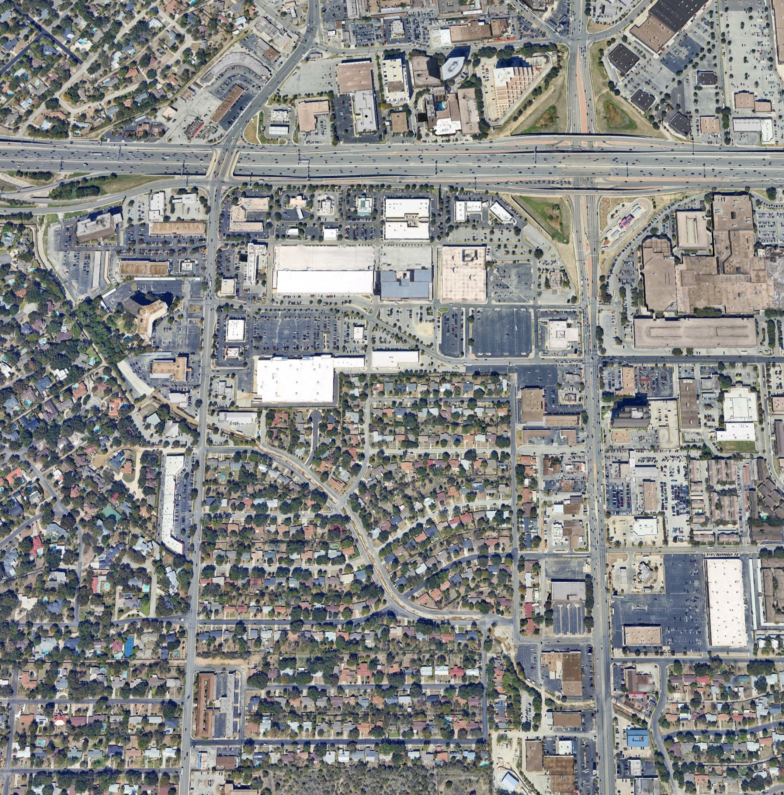












































































CASTLE CREEK VILLAGE
6401-6487 BLANCO RD | SAN ANTONIO | TEXAS | 78216
Blanco Rd
San Pedro Ave
250,000 VPD
SITE
27,500 VPD
Blanco Road
For More Information Contact: Joe M. Kboudi, Omri Russo
Joe M. Kboudi Real Estate, Inc.
7300 Blanco Road, Suite 706 San Antonio, Texas 78216
TEL: (210) 344-1002
FAX: (210) 342-3405
www.kboudi.com jmkboudi@aol.com
omri@kboudi.com
This information has been secured from sources deemed to be reliable, but we made no representation on warranties expressed or implied, as to the accuracy of the information. References to square footage or age are approximate. Buyer must verify the information and bears all risk of any inaccuracies.

Slide 3
CASTLE CREEK VILLAGE
6401-6487 BLANCO RD | SAN ANTONIO | TEXAS | 78216

Slide 4
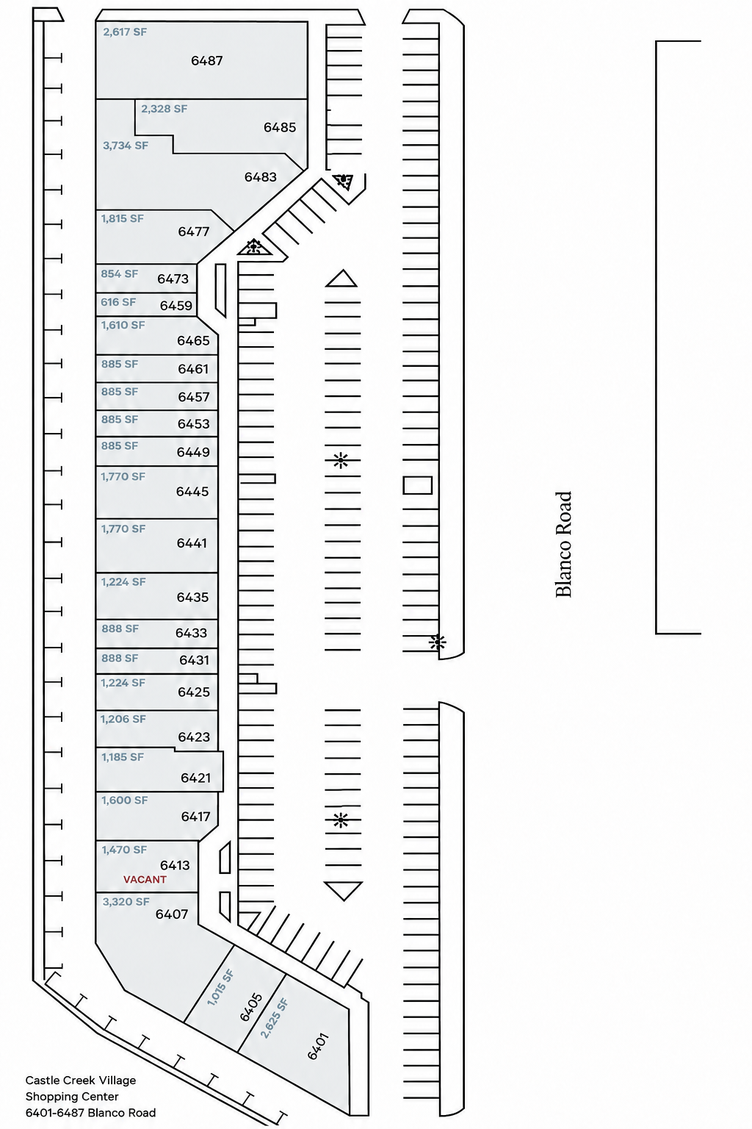
CASTLE CREEK VILLAGE
6401-6487 BLANCO RD | SAN ANTONIO | TEXAS | 78216
SITE PLAN
1,470 SF
Blanco Road
For More Information Contact: Joe M. Kboudi, Omri Russo
Joe M. Kboudi Real Estate, Inc.
7300 Blanco Road, Suite 706 San Antonio, Texas 78216
TEL: (210) 344-1002
FAX: (210) 342-3405
www.kboudi.com jmkboudi@aol.com
omri@kboudi.com
This information has been secured from sources deemed to be reliable, but we made no representation on warranties expressed or implied, as to the accuracy of the information. References to square footage or age are approximate. Buyer must verify the information and bears all risk of any inaccuracies.

Slide 5
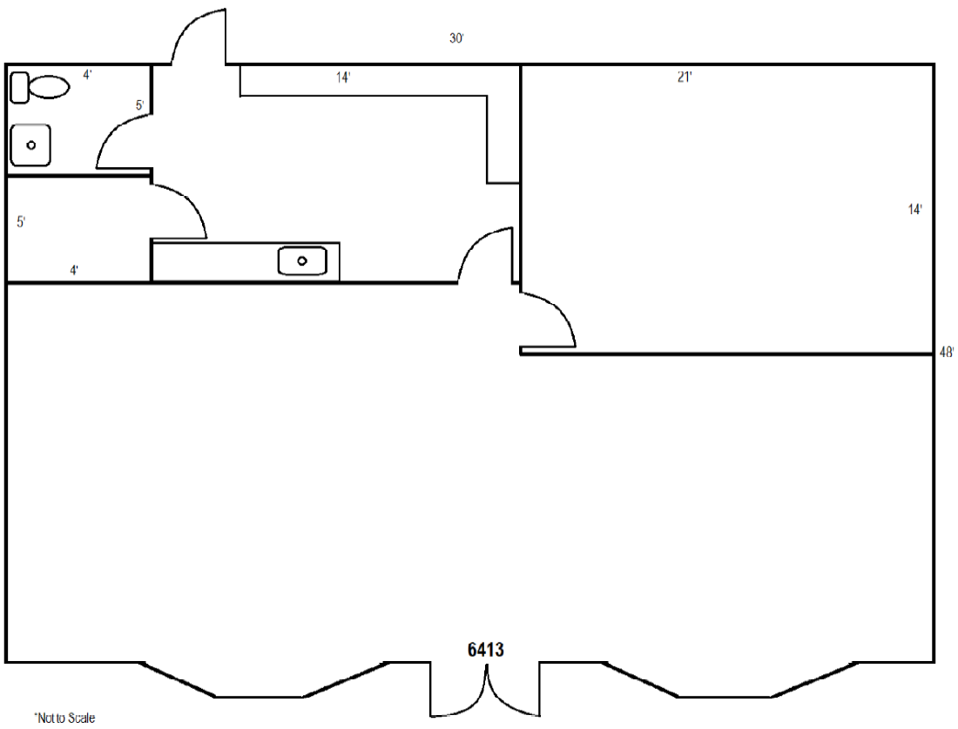
CASTLE CREEK VILLAGE
6401-6487 BLANCO RD | SAN ANTONIO | TEXAS | 78216
Suite 6413 Floor Plan – 1,470 SF
For More Information Contact: Joe M. Kboudi, Omri Russo
Joe M. Kboudi Real Estate, Inc.
7300 Blanco Road, Suite 706 San Antonio, Texas 78216
TEL: (210) 344-1002
FAX: (210) 342-3405
www.kboudi.com jmkboudi@aol.com
omri@kboudi.com
This information has been secured from sources deemed to be reliable, but we made no representation on warranties expressed or implied, as to the accuracy of the information. References to square footage or age are approximate. Buyer must verify the information and bears all risk of any inaccuracies.

Slide 6
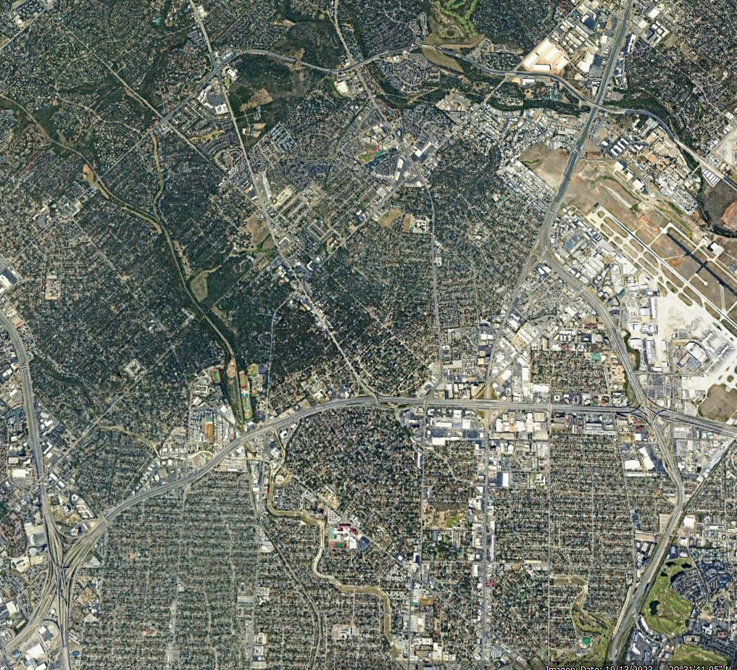








CASTLE CREEK VILLAGE
6401-6487 BLANCO RD | SAN ANTONIO | TEXAS | 78216
SITE
For More Information Contact: Joe M. Kboudi, Omri Russo
Joe M. Kboudi Real Estate, Inc.
7300 Blanco Road, Suite 706 San Antonio, Texas 78216
TEL: (210) 344-1002
FAX: (210) 342-3405
www.kboudi.com jmkboudi@aol.com
omri@kboudi.com
This information has been secured from sources deemed to be reliable, but we made no representation on warranties expressed or implied, as to the accuracy of the information. References to square footage or age are approximate. Buyer must verify the information and bears all risk of any inaccuracies.

Slide 7
CASTLE CREEK VILLAGE
6401-6487 BLANCO RD | SAN ANTONIO | TEXAS | 78216

Slide 8
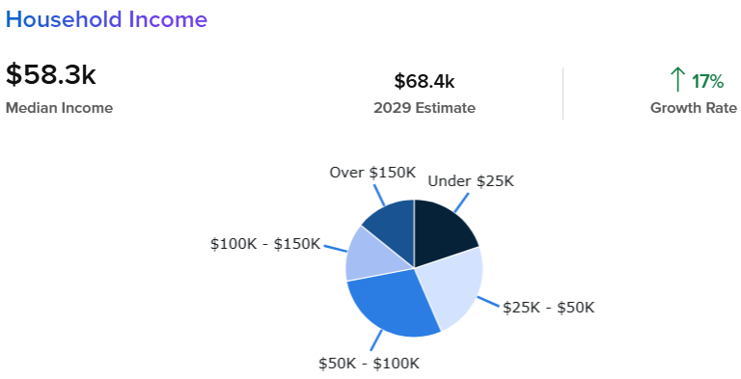
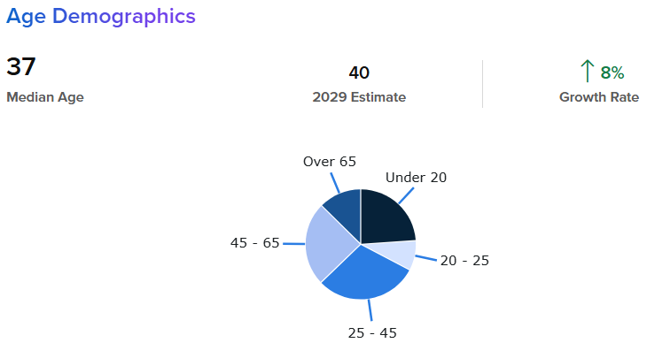
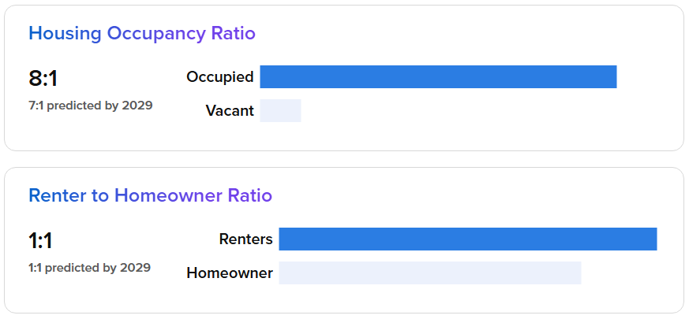
CASTLE CREEK VILLAGE
6401-6487 BLANCO RD | SAN ANTONIO | TEXAS | 78216
Demographics
Key Variables | 1.00 Mile Radius | 3.00 Mile Radius | 5.00 Mile Radius
Population | 28,642 | 169,767 | 435,931
Average Household Income | $71,047 | $82,521 | $91.121
Population
2024 Estimated Population | 28,642 | 169,767 | 435,931
Total Employees | 23,805 | 139,740 | 358,929
Median Age | 38.9 | 37.3 | 36.7
Income
Median Household Income | $54,052 | $58,263 | $62,304
Average Household Income | $71,047 | $82,521 | $91.121
Housing
Total Households | 12,286 | 71,452 | 184,285
Owner | 5,152 | 31,721 | 78,737
Renter | 7,134 | 39,721 | 105,548
For More Information Contact: Joe M. Kboudi, Omri Russo
Joe M. Kboudi Real Estate, Inc.
7300 Blanco Road, Suite 706 San Antonio, Texas 78216
TEL: (210) 344-1002
FAX: (210) 342-3405
www.kboudi.com jmkboudi@aol.com
omri@kboudi.com
This information has been secured from sources deemed to be reliable, but we made no representation on warranties expressed or implied, as to the accuracy of the information. References to square footage or age are approximate. Buyer must verify the information and bears all risk of any inaccuracies.

Slide 9


11-2-2015
Information About Brokerage Services
Texas law requires all real estate license holders to give the following information about
brokerage services to prospective buyers, tenants, sellers and landlords.
TYPES OF REAL ESTATE LICENSE HOLDERS:
.
A BROKER is responsible for all brokerage activities, including acts performed by sales agents sponsored by the broker.
A SALES AGENT must be sponsored by a broker and works with clients on behalf of the broker.
A BROKER’S MINIMUM DUTIES REQUIRED BY LAW (A client is the person or party that the broker represents):
Put the interests of the client above all others, including the broker’s own interests;
Inform the client of any material information about the property or transaction received by the broker;
Answer the client’s questions and present any offer to or counter-offer from the client; and
Treat all parties to a real estate transaction honestly and fairly.
A LICENSE HOLDER CAN REPRESENT A PARTY IN A REAL ESTATE TRANSACTION:
AS AGENT FOR OWNER (SELLER/LANDLORD): The broker becomes the property owner's agent through an agreement with the owner, usually in a written listing to sell or property management agreement. An owner's agent must perform the broker’s minimum duties above and must inform the owner of any material information about the property or transaction known by the agent, including information disclosed to the agent or subagent by the buyer or buyer’s agent.
AS AGENT FOR BUYER/TENANT: The broker becomes the buyer/tenant's agent by agreeing to represent the buyer, usually through a written representation agreement. A buyer's agent must perform the broker’s minimum duties above and must inform the buyer of any material information about the property or transaction known by the agent, including information disclosed to the agent by the seller or seller’s agent.
AS AGENT FOR BOTH - INTERMEDIARY: To act as an intermediary between the parties the broker must first obtain the written agreement of each party to the transaction. The written agreement must state who will pay the broker and, in conspicuous bold or underlined print, set forth the broker's obligations as an intermediary. A broker who acts as an intermediary:
Must treat all parties to the transaction impartially and fairly;
May, with the parties' written consent, appoint a different license holder associated with the broker to each party (owner and buyer) to communicate with, provide opinions and advice to, and carry out the instructions of each party to the transaction.
Must not, unless specifically authorized in writing to do so by the party, disclose:
  that the owner will accept a price less than the written asking price;
  that the buyer/tenant will pay a price greater than the price submitted in a written offer; and
  any confidential information or any other information that a party specifically instructs the broker in writing not to disclose, unless required to do so by law.
AS SUBAGENT: A license holder acts as a subagent when aiding a buyer in a transaction without an agreement to represent the buyer. A subagent can assist the buyer but does not represent the buyer and must place the interests of the owner first.
TO AVOID DISPUTES, ALL AGREEMENTS BETWEEN YOU AND A BROKER SHOULD BE IN WRITING AND CLEARLY ESTABLISH:
The broker’s duties and responsibilities to you, and your obligations under the representation agreement.
Who will pay the broker for services provided to you, when payment will be made and how the payment will be calculated.
LICENSE HOLDER CONTACT INFORMATION: This notice is being provided for information purposes. It does not create an obligation for you to use the broker’s services. Please acknowledge receipt of this notice below and retain a copy for your records.
Joe M. Kboudi Real Estate, Inc.
446375 joe@kboudi.com
License No. Email
276333 joe@kboudi.com
License No. Email
(210) 344-1002
Licensed Broker /Broker Firm Name or Primary Assumed Business Name
Joe M. Kboudi
Phone
(210) 344-1002
Designated Broker of Firm
Phone
Licensed Supervisor of Sales Agent/ Associate
Omri S. Russo
License No.
643027
Email
omri@kboudi.com
Phone
(210) 344-1002
Sales Agent/Associate’s Name
License No.
Email
Phone
Buyer/Tenant/Seller/Landlord Initials
Date
Regulated by the Texas Real Estate Commission
Information available at www.trec.texas.gov
IABS 1-0

